Slide 1





Final Project
Customer Behavior for a online shop
Qiqin Yang

Slide 2
Final Project
Customers' Behavior in an online shop
Qiqin Yang

Slide 3
About E-Commerce
50%
22%
25%
100%
Annual Growth Rate
Total
Retail Market
Total Population
Time
of a Day
69%
2.8%
Abandon Rate
Convert Rate

Slide 4
About Database
A. Cosmetics Online Shop
B. 3.6M records from Dec 2019 about customers' clicks in the shop
C. It contains User-ID, Session-time, Session ID, Price, Product, Event
D. 4 Events been recorded: View, Cart, Remove from cart, Purchase

Slide 5
About Data Analyst
Challenges:
A. Each user has an unique User ID
B. Each order may have multiple Session IDs
What I did:
A. Group the data with User ID and Session ID
B. Force on the last event of each session
C. Gathering information – 248k unique sessions
D. Built Machine Learning Modules – Linear Regression and Classification

Slide 6
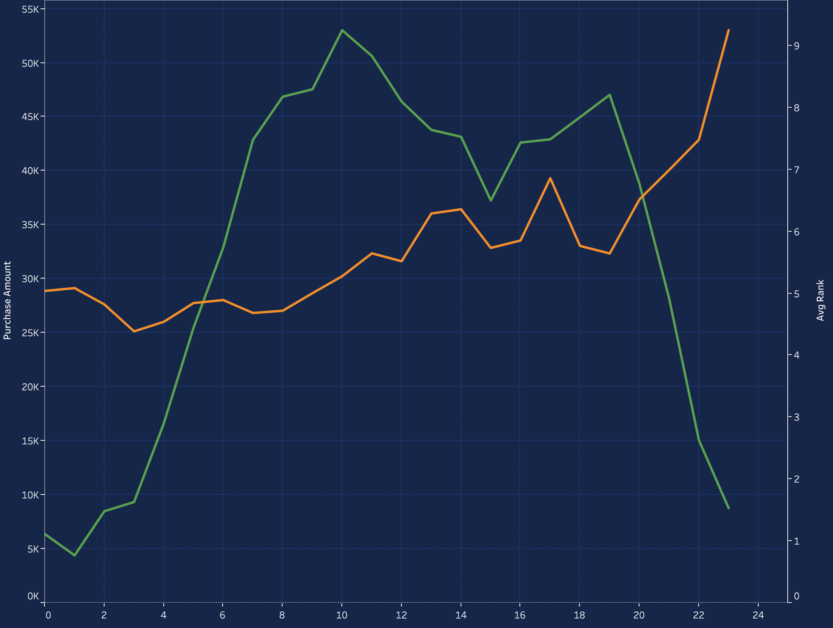
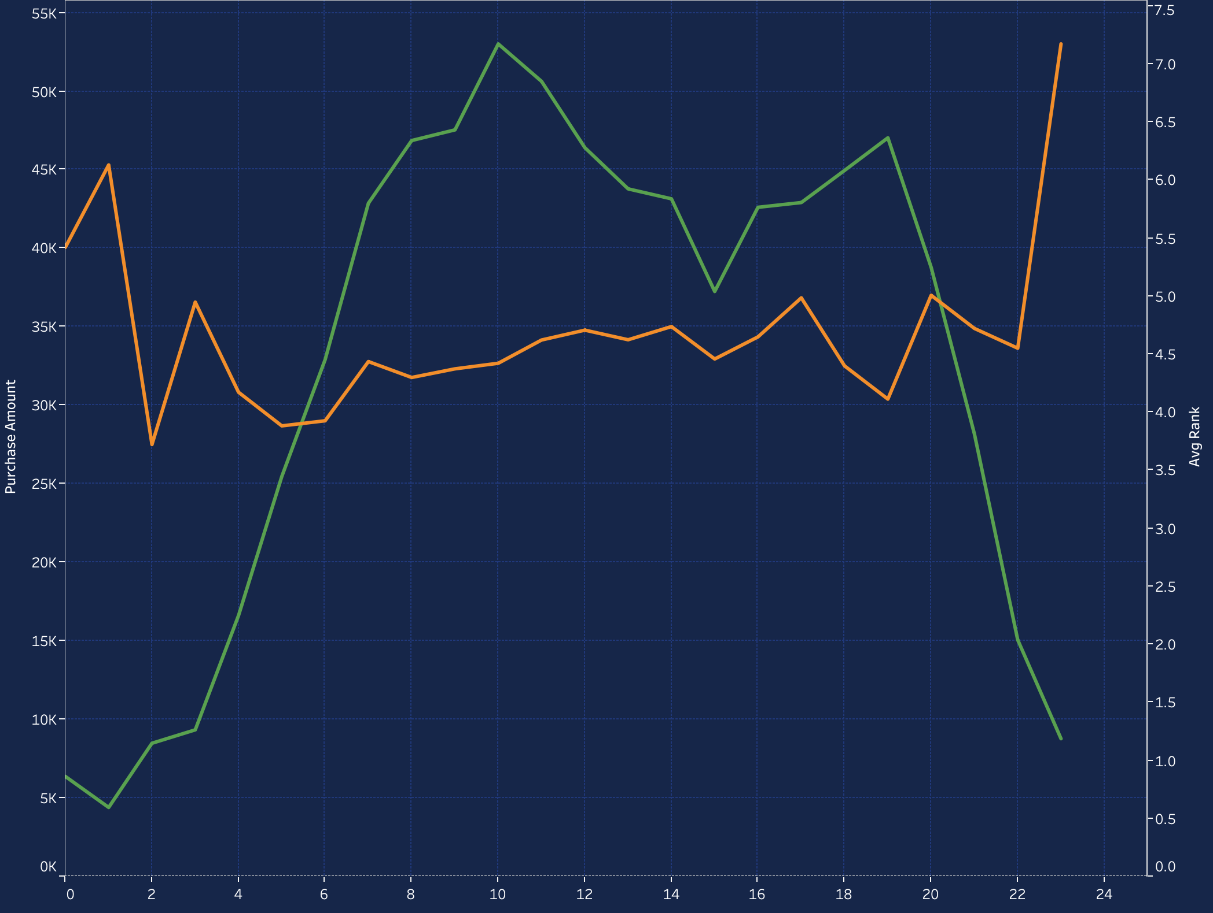
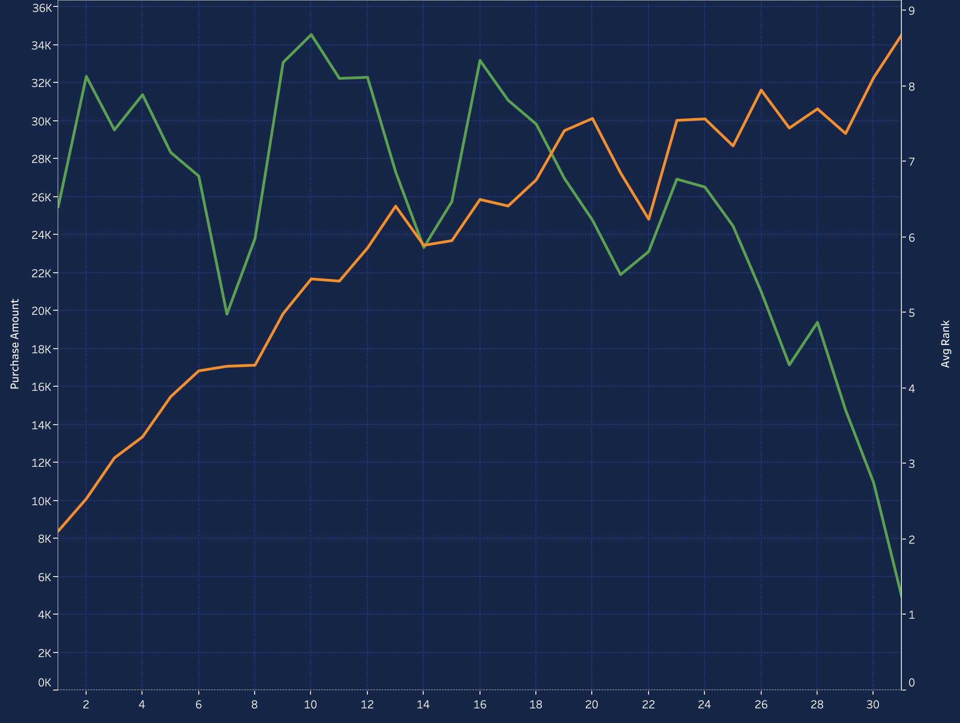
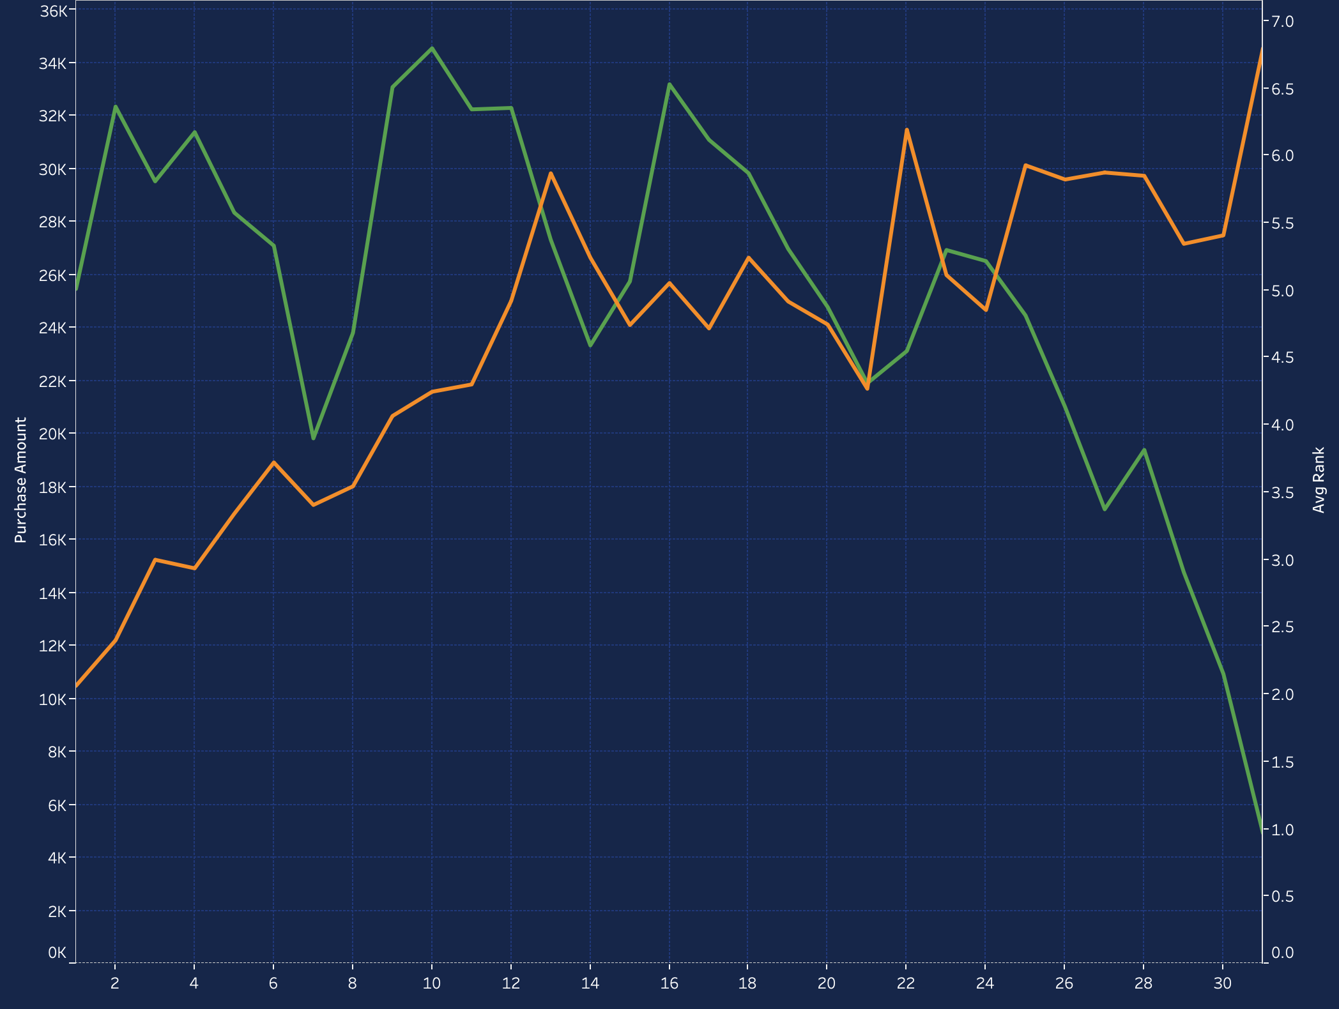
About Result
Visit times VS purchase amount over the day:
Visit times VS purchase amount in a month:

Slide 7



About Result
View vs Purchase:
% of Revenue: Monday to Sunday
% of Revenue: Night/Morning/Afternoon/Night

Slide 8
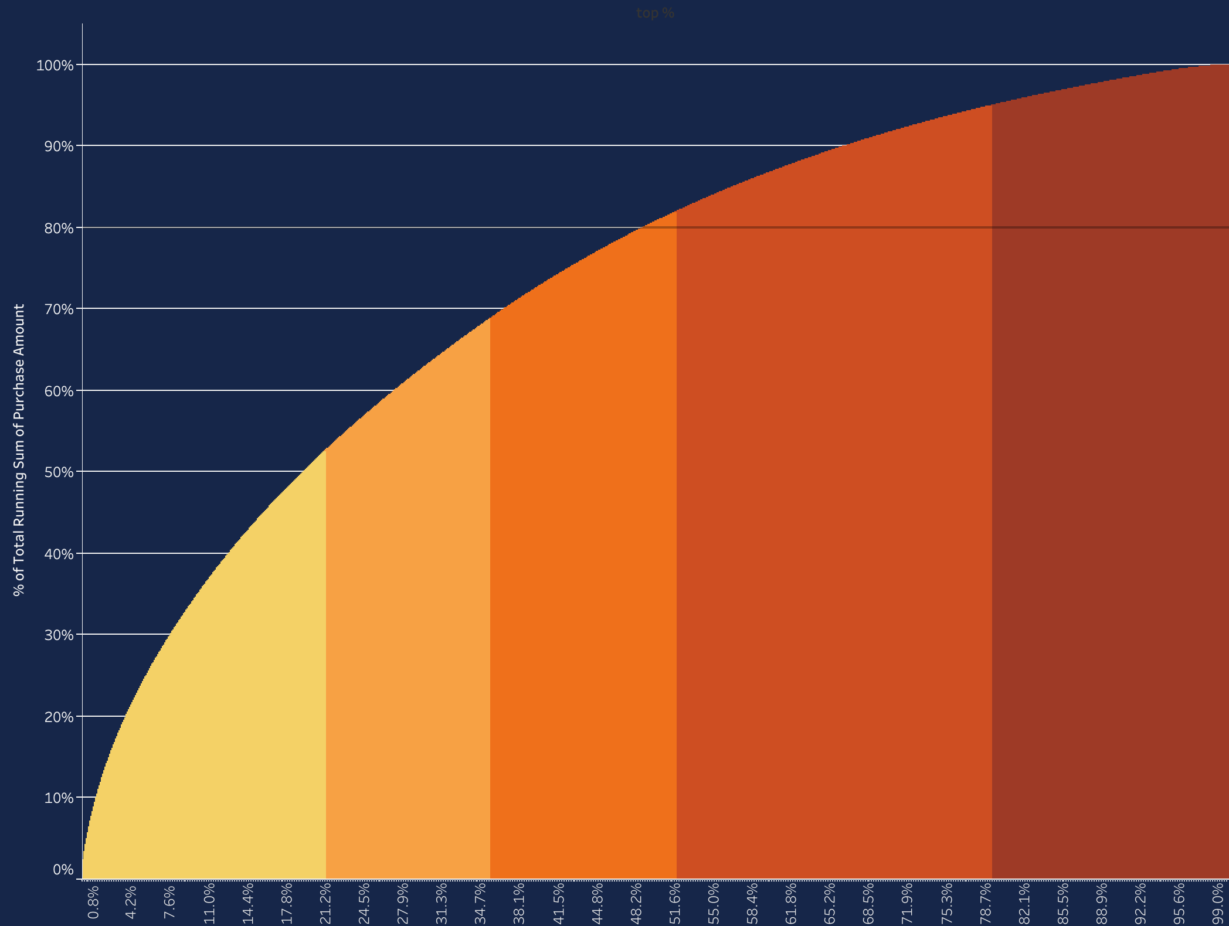
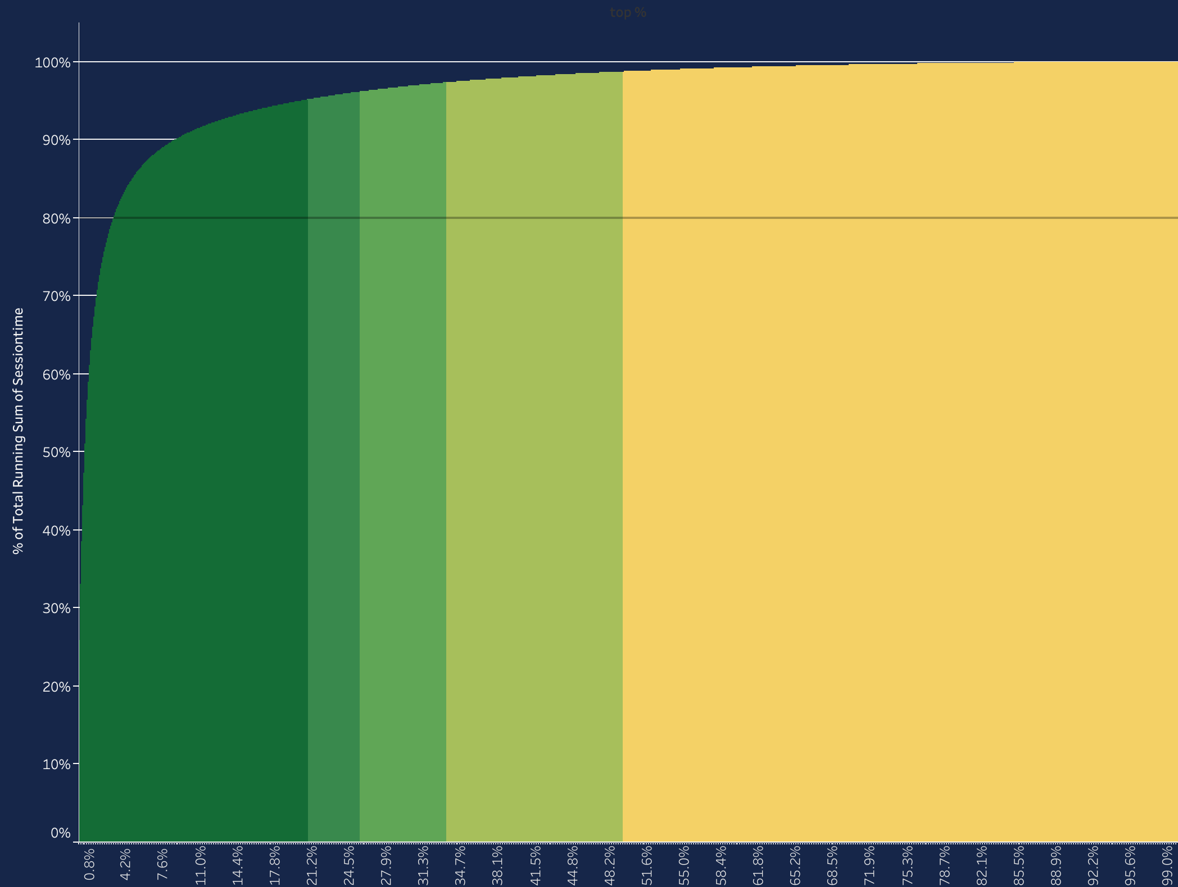
About Result
Top % Purchase Amount:
Top % Session Time:
20%
53%
20%
95%

Slide 9
About Summary
A. Paretos' Principle
B. Increase revenue from top 20% customers
C. Reduce session time from top 20% customers with more accurate search results
D. Monday morning

Slide 10
Thank You
Data source:
https://rees46.com
https://www.kaggle.com/mkechinov/ecommerce-events-history-in-cosmetics-shop
Statistic Quelle:
https://www.oberlo.com/blog/ecommerce-statistics
https://www.statista.com/topics/871/online-shopping/
https://www.statista.com/statistics/379046/worldwide-retail-e-commerce-sales/

